Slide 1
Native code in web development stack
Part 1

Slide 2
Taxonomy
Front-end
Back-end
WebCL, WebGL
Emscripten, Binaryen, WebAssembly – not strictly native code
Entire application
Native extensions for scripting languages

Slide 3
Front-end
gpu

Slide 4

WebGL
Core
Core
Core
Core
Core
Core
Core
Core
Core
Rasterization
This Photo by Unknown Author is licensed under CC BY-SA

Slide 5
GPU vs CPU
CPU
GPU
Core
Core
Core
Core
Core
Core
Core
Core
Core
Core
Core
Core
Core
Core
Core
Core
Core
Core
Core
Core
Core
Core
Core
Core
Core
Core
Core
Core
Core
Core
Core
Core
Core
Core
Core
Core
Core
Core
Core

Slide 6
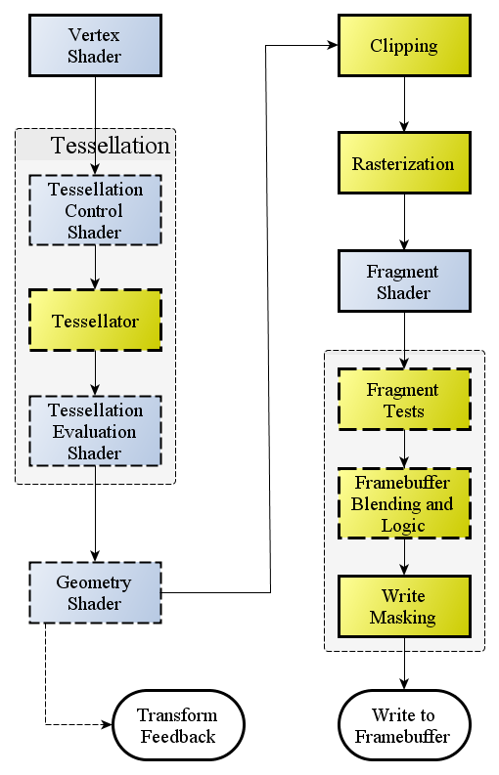
Rendering pipeline
This Photo by Unknown Author is licensed under CC BY-SA

Slide 7
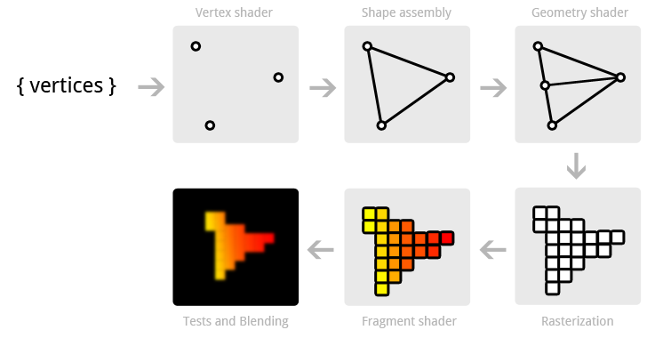
Shaders
This Photo by Unknown Author is licensed under CC BY-SA

Slide 8
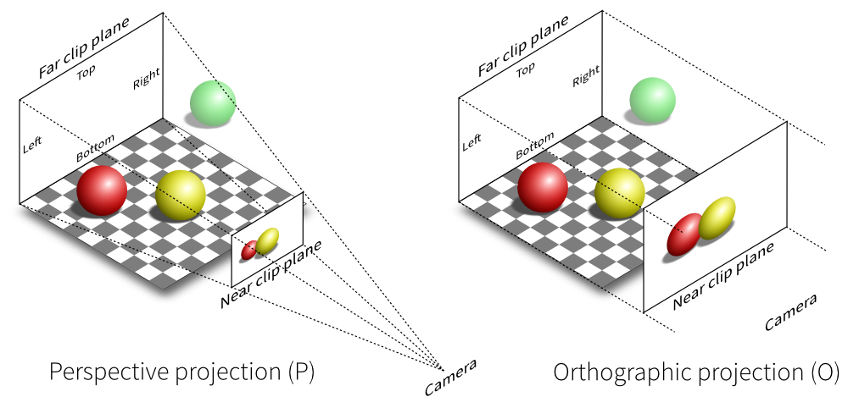
3D
This Photo by Unknown Author is licensed under CC BY-SA

Slide 9
WebCL(OpenCL)
Data
Data
OpenCL

Slide 10
Problem setup
0, 0
1, 0
0, 1
1, 1
Notes:
CW, CCW

Slide 11

Problem setup
0, 0
1, 0
0, 1
1, 1
Notes:
CW, CCW

